Slide 1

DDoS Mitigation
Yinon Cohen and Maor Shabtay
Advisor: Dr. Amit Dvir
September 2018

Slide 2
Motivation
Motivation
In out 2nd year, we made a phishing website over Amit Dvir's website.
In order to download his entire site without working hard, we used HtTrack software.
We ran it several times – and it made a DoS attack which shut down his website.
DDoS Mitigation - Traffic Flood Attacks
Our project is a system, running on a CDN server, which analyzes and identifying which requests are valid and which are part of DoS or DDoS attacks.

Slide 3
DoS and DDoS - In General
DoS and DDoS
To divide types of DoS and DDoS attacks, we will use OSI model:
Application layer
HTTP POST Flood - Creating and sending very large number of POST methods.
HTTPS POST Flood – Great amount of post methods through Secure Sockets Layer (SSL) Session.
HTTP GET Flood – Creating and sending to the server a huge amount of GET requests. The server needs to analyze all of them and return some data.
HTTPS GET Flood - Overflow of GET requests on HTTPS protocol requires a lot of work from SSL Session.
Transport layer
Syn Flood – The attacker takes advantage of the TCP principles that the server always wants to reach (3 hand shake).
Rst Flood - In case that a socket is closed or when one of the sides disconnected, client sends a packet with a Rst flag to re-open the connection.
UDP

Slide 4
DoS and DDoS - In General
DoS and DDoS
Network layer
DoS and DDoS attacks over the Network layer are characterized with a large number of packets in order to overload the bandwidth and exhaust network resources (routers, firewalls and servers).
ICMP Flood - ICMP protocol is typically used for error messages between systems. Flooding messages with ICMP protocol – e.g. ping – is intended to overload the network.
Link layer
DoS and DDoS attacks over the network layer require access to the local network.
Media Access Control (MAC) Flood - A rare attack, which the attacker must be connected to the local switch. The attacker sends multiple dummy Ethernet frames, each with different invalid MAC address.
APDoS Attack
The Advanced Persistent Denial-of-Service (APDoS) is an attack that combines many DoS and DDoS attacks, and is carried out by a lot of hostile elements over time. The idea behind it is a combination of many attacks from multiple endpoints, and over long period of time, hence its name Advances Persistent DoS.

Slide 5
How Do we Mitigate?
Our related workers, (Check Point, CISCO, `doi` operations) had used several approaches in order to mitigate DoS and DDoS attacks:
Analyzing the whole network, determining which state is a regular state, and which is under DoS or DDoS attack.
Blocking any suspicious end-point if needed (flooder) - sometimes the whole subnet.
Forwarding the good traffic to maintain business continuity.
Our Innovations:
Developing the whole algorithm upon the CDN server, and not on the server itself.
Ranking requests by their significance and traffic bandwidth.
Innovations

Slide 6
Difficulties
Building our own system
In order to determine the specific behavior and requests handling, we must develop our servers:
Coding a server which listens and handles all requests.
Coding a client end-point which could send regular request or multiple flooding requests over the server.
Developing a CDN server, which accepts requests from clients, following them to the server, and return answers it to the right client.
Creating a proper network environment
To determine that our system really providing a proper solution for DoS and DDoS attacks, we had to:
Creating a network simulation of our network architecture.
Use it in a third-party application to demonstrate a real DoS and DDoS attack.
Experimenting the system
After planning, developing and using our system, we should decide if it is a proper solution for servers.
Experimenting our system, and analyzing it against other existing solutions.
Difficulties

Slide 7
Our Mitigation
Our mitigating algorithm consists several components, working on the CDN server:
Initializing - CDN server ask from the server list of request answers and ranks them by significance.
Before starting being available to clients.
When accepting a request, determining either it's dummy request
Blocking flooding end-points.
Reset marks each X time.
Mitigation

Slide 8

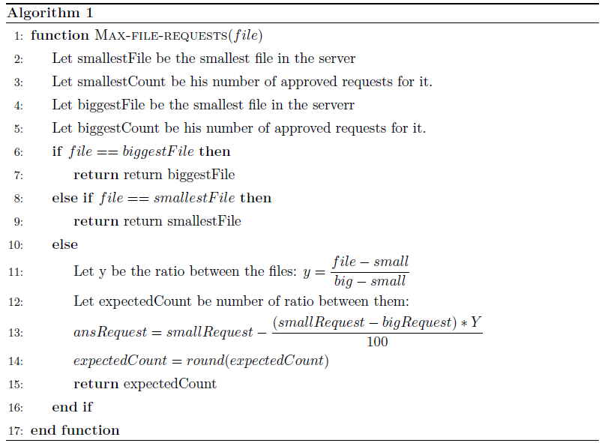
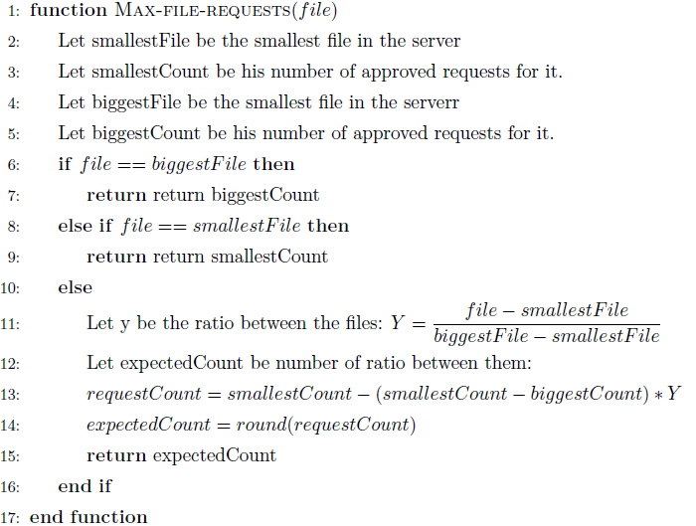

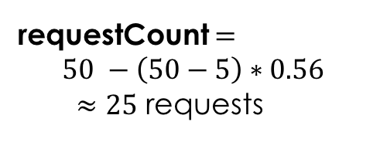
Calculating approved count of times for each file
5 MB
500 KB
50 requests
5 requests
3 MB
Algorithms
?? requests
Y = $\frac{3000 −500}{5000 −500}= \frac{2500}{4500}≈0.56$
requestCount $=$
$$50 −\left(50−5\right)∗0.56$$
$≈25$ requests
Notes:
נניח כי גודל הקבצים הם מ-500 ק"ב עד 5 מ"ב
ונניח כי בקשה קטנה ניתן לבקש 100 פעמים ובקשה גדולה נאפשר 25 פעמים.
כעת מגיעה בקשה לקובץ השוקל 3 מ"ב.
השאלה כמה בקשות נאפשר לו?
Y = (3000-500)/(5000-500) = 2500/4500=0.56
AnssRequest = 100 – ((100-25)*0.56) = 100-75*0.56 =58
נקבל סה"כ 58 בקשות.
חצי = 2250 = 62

Slide 9
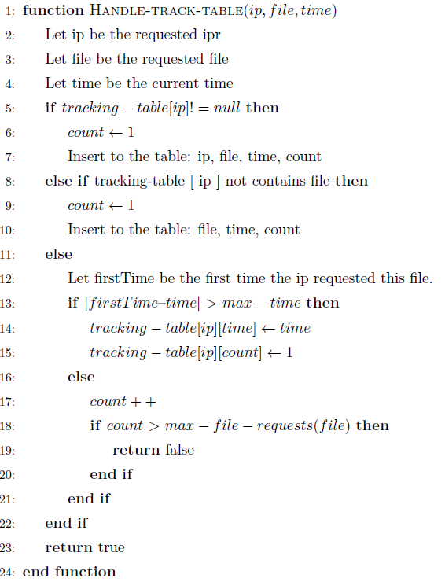
Handle request for tracking table
Algorithms

Slide 10
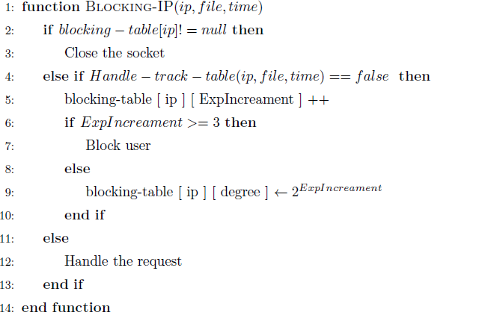

Handle request
Algorithms
Intervals

Slide 11
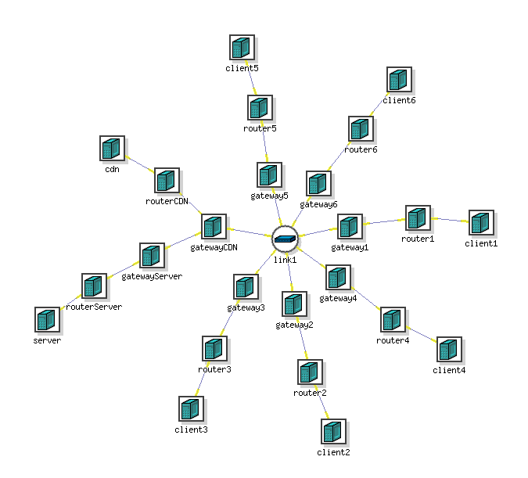

CREATE
CDN
CREATE
Server

Slide 12
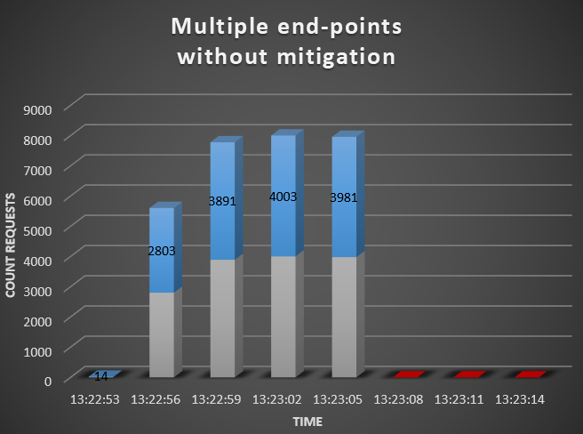
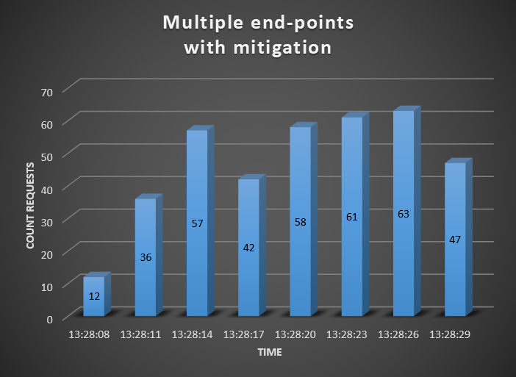
Experiments
Experiments

Slide 13





Integration
No Tests = No System
Our project is manages by Git, and connected directly to Continuous Integration server.57 tests - 52 units and 5 integration tests.
Lint - EsLint - around 30 rules.
Circle Ci integration server - each commit in GitHub must pass CI before merged to master branch.
Integration

Slide 14
Conclusion
DoS and DDoS protections have existed for many years.
However, there is no protection intended and researched specific for Application-Layer (OSI) flood attacks.
In order to build our system, we successfully meet the following requirements:
Investigating what is DoS and DDoS attacks, focusing on Application-Layer - http flood attacks.
Researching about other existing solutions, which already invented such defenses / algorithms.
Developing our own servers, and end-points representing clients or attackers.
Experimenting our system with several tools - Integration tools and multi end-points servers.
Brand New Innovations
CDN implementation - CDN server should allow the server deal with the databases and to perform complex calculations and run the algorithm itself.
Ranking requests significance - less dealing with small significant requests (in terms of bandwidth and calculation).
Conclusion

Slide 15
Future work
We’ve done a huge research work, and built multiple modules that could handle DoS and DDoS attacks when needed.
However, we would like to suggest a few improvements for our system:
Not only Application-layer mitigation, but also transport and link layers.
“White List” and “Black List”.
Extending our system for Apache and cloud servers.
Testing Implementations - Asynchronous Single Threaded and Synchronous Multi-Threaded.
Future DoS and DDoS attacks.
Future work

Slide 16
Questions ?

